Slide 1
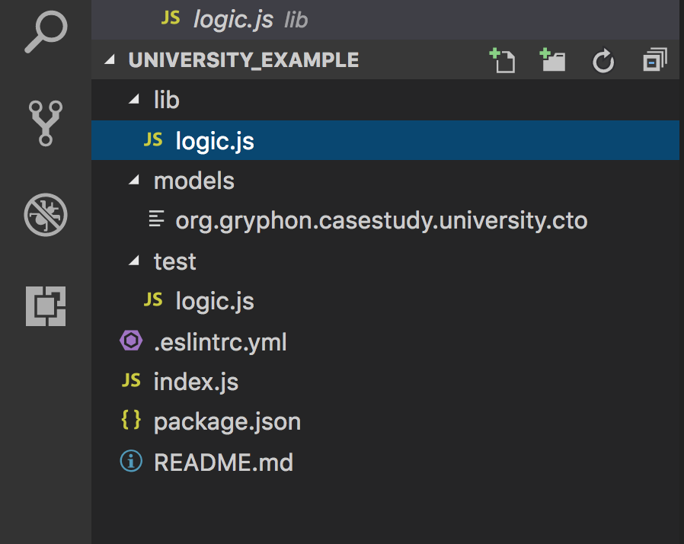
Chaincode
Test Logic

Slide 2
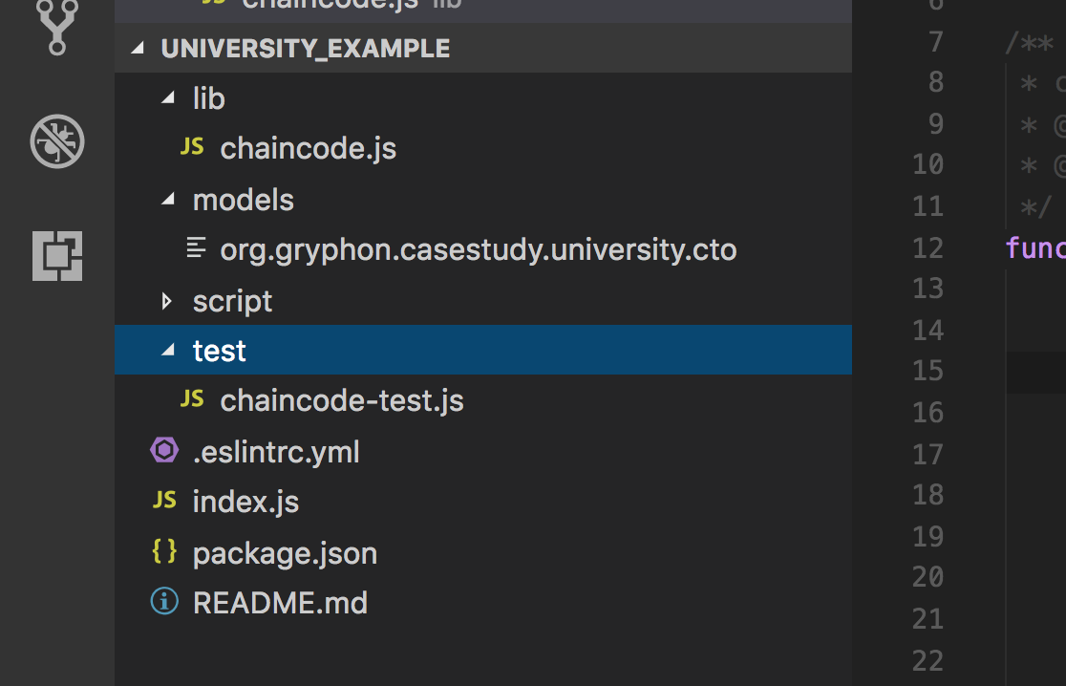
Replaced
Edited
Added
Replaced

Slide 3
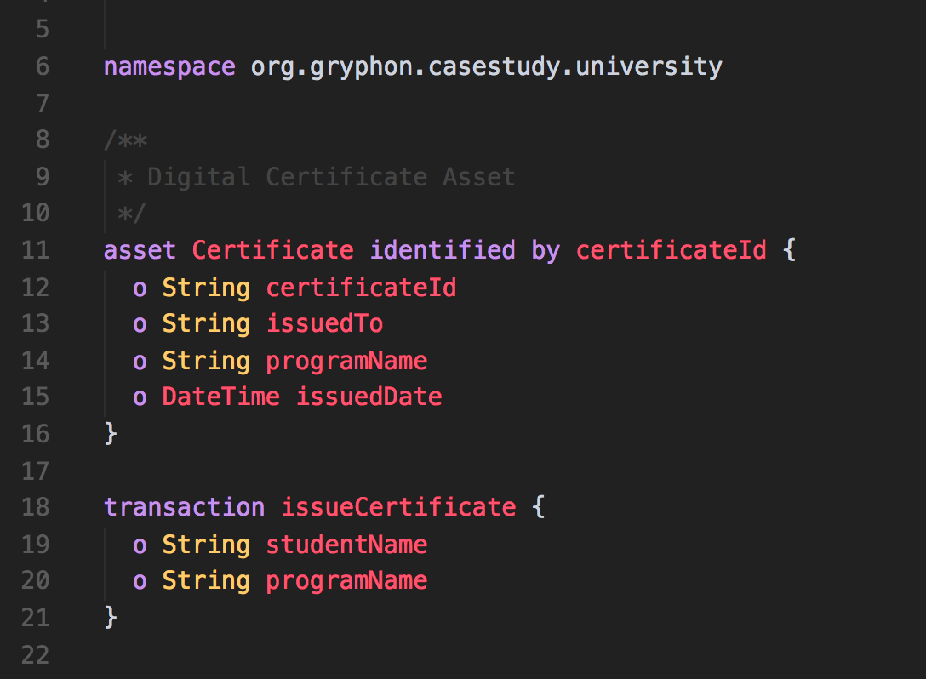
Name Space defination
Defining a Certificate Asset
Defining a Transaction which will create new asset in the registry

Slide 4
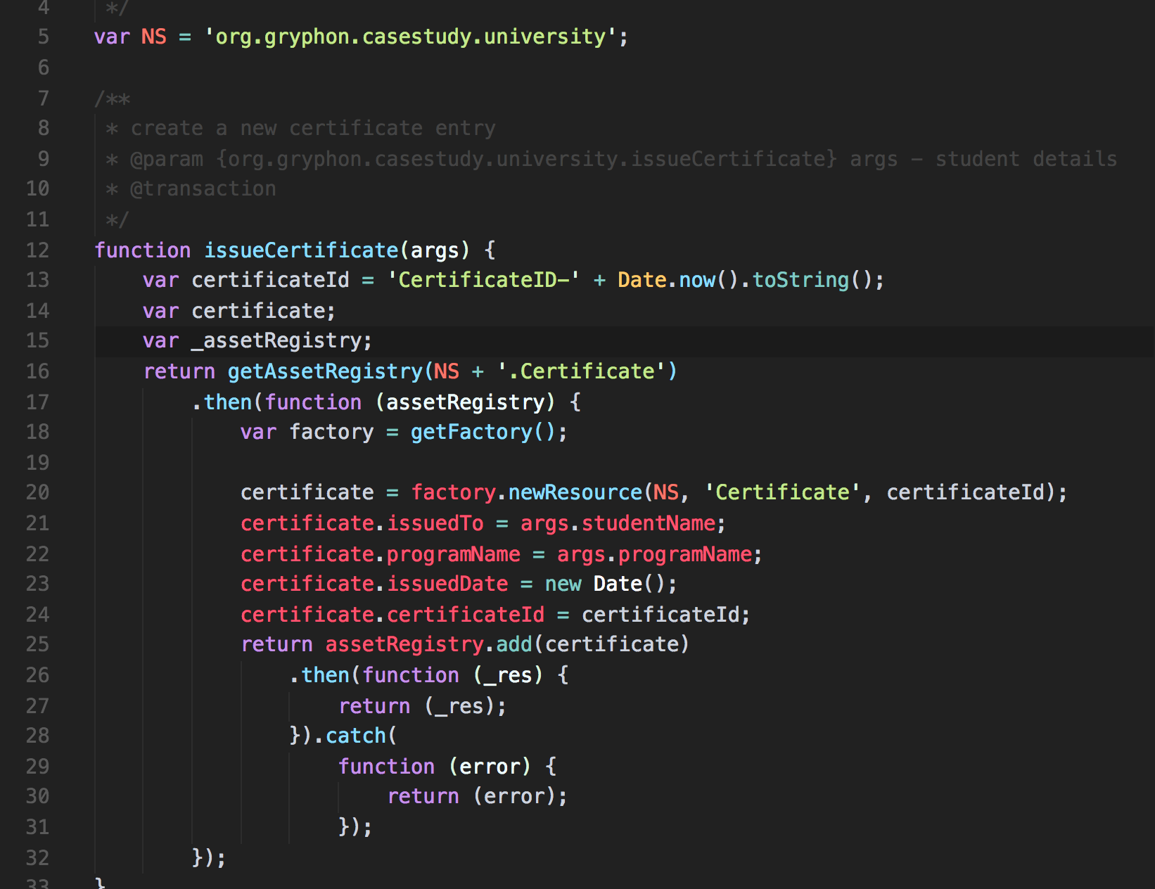
Reference to the transaction in model cto file
Selected function name with arguments
Get Certificate Asset Registry
Create & Update necessary Certificate parameters
Add new Certificate to Registry

Slide 5
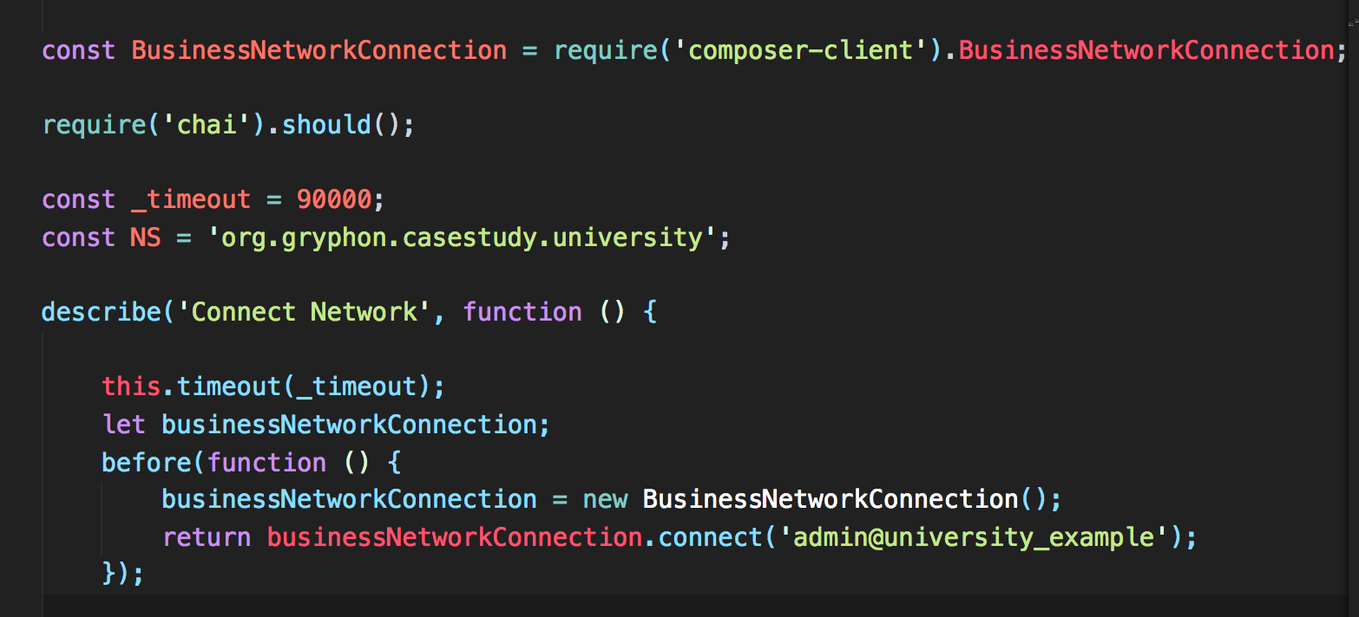
Use composer client to connect to the Business Network
Using ‘ CHAI ’ framework for testing
Before any test connect to the network
Use admin card to connect to the Business network

Slide 6
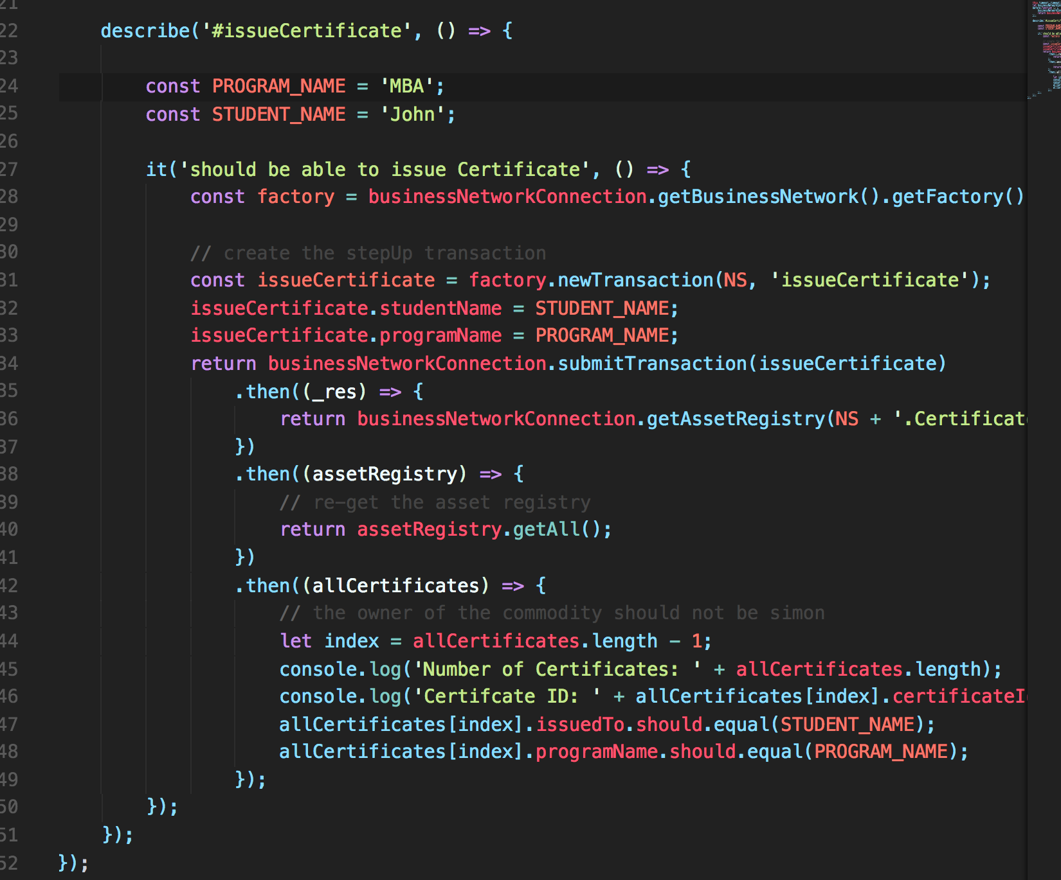
Start 1st Test in ‘it’ block
Create Transaction
Define inputs to transaction function
Submit Transaction
Get Certificate Registry for validation
All Items returned
Display last certificate entry
Validate the entry using chai test

Slide 7


Create a Business Network
Start Fabric & Create Peer Admin
Create Archive & Deploy Runtime
Test Chaincode
Launch & Use Explorer
Write Basic Chaincode

Slide 8
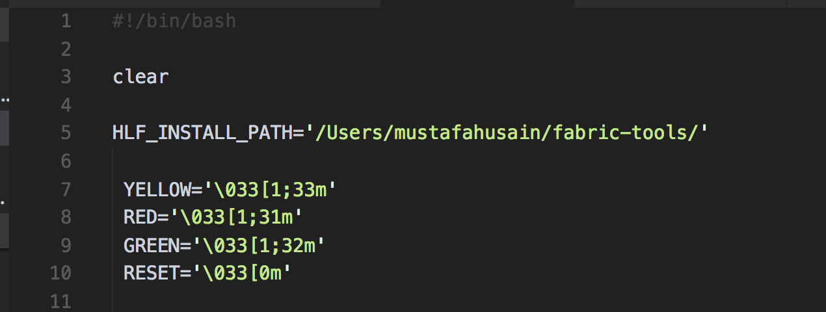
YOUR-USER NAME

